Slide 1
Contact Networks
Sean Patch

Slide 2
Outline
Network Epidemics Background
Sexually Transmitted Diseases
Airborne Diseases
Global Travel Network
Local Contact Network
Location Network
Digital Viruses

Slide 3
Previous Models
Assumed that any individual can contact any other individual
False: only close proximity can spread a pathogen
Assumed that all individuals have a similar number of connections (〈k〉)
False: many contact networks are scale-free, so〈k〉cannot characterize the network
New model: use degree k as a variable

Slide 4
Network Epidemics
𝛕 - characteristic time (time to spread to ~36% of population)
λ_{c} - epidemic threshold
Both of these are affected by〈k²〉 (second moment)
For scale-free networks: as N →∞, 〈k²〉→∞
𝛕→0, λc→0
Notes:
Table shows different epidemic models within scale-free networks
You can also analyze random networks, but most contact networks end up being more scale-free
Viruses that are hard to pass from person to person can still spread in a scale-free network
A hub is more likely to be infected since it has many connections
If a hub is infected, it can pass the disease on to many other nodes
Similar properties between scale-free and high k2 networks

Slide 5
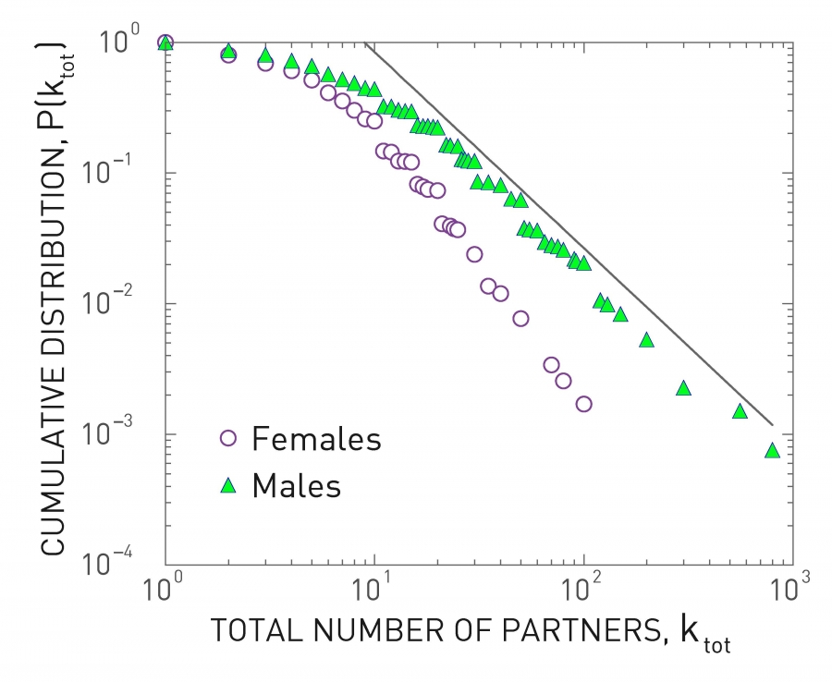
Sexually Transmitted Diseases
HIV
Survey of 4,781 randomly selected Swedes
Scale-free network
High〈k²〉
First empirical evidence of the relevance of scale-free networks in the spread of pathogens
Notes:
4,781 randomly selected Swedes asked to estimate their total number of sexual partners

Slide 6
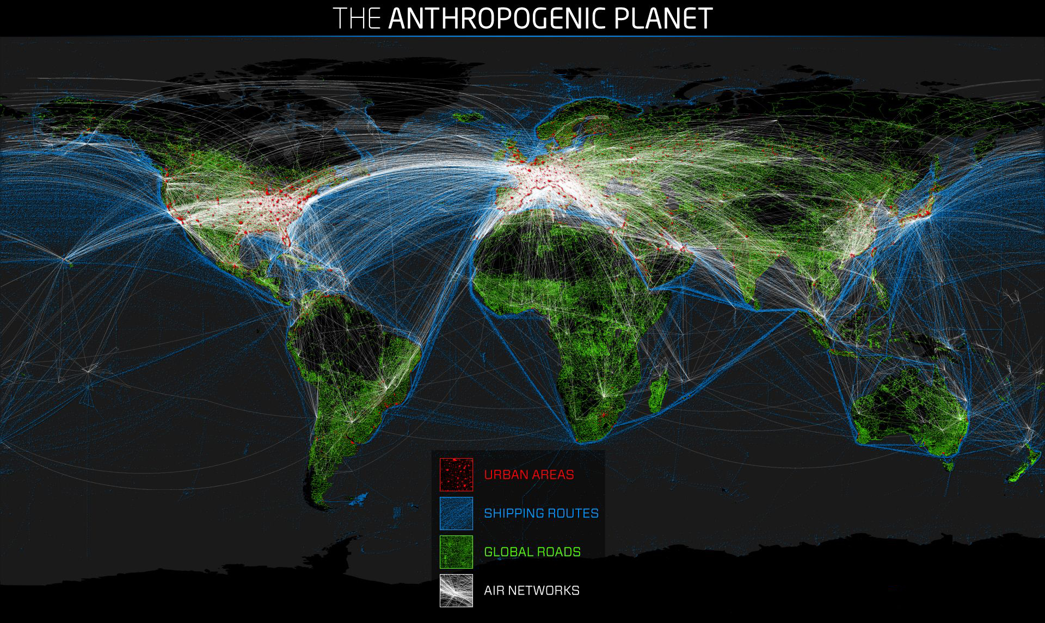
Airborne Diseases
Influenza, SARS, H1N1
Spread through close physical proximity
Two levels to analyze
Global Travel Network
Local Contact Network

Slide 7
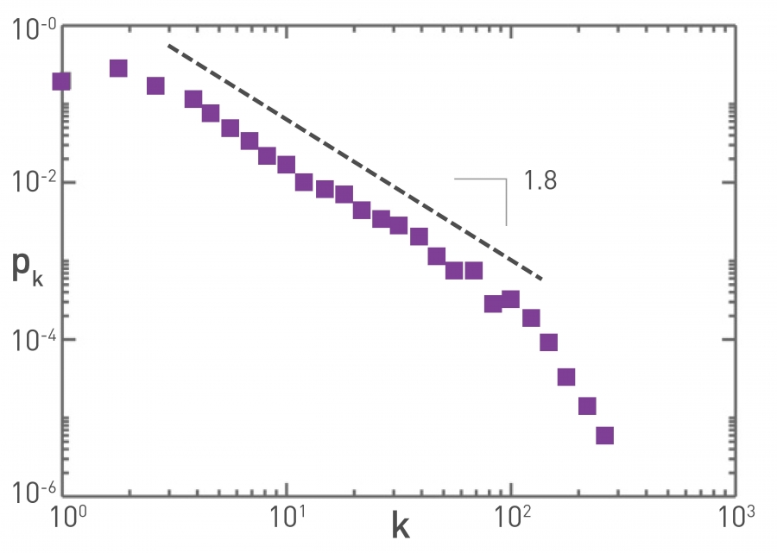
Global Travel Network
Air travel determines how fast the pathogen can move around the planet
Air Transportation Network
Airports as nodes, direct flights as edges
Scale-free
2002 Air Transportation Network
γ =1.8 ±0.2

Slide 8
Local Contact Network
Face-to-face interactions
Can be difficult to determine precise contact network
Data is usually lacking
RFID
Radio Frequency Identification
Notes:
For air transportation, we have accurate data of the network
For local contact networks, we usually lack sufficient data

Slide 9
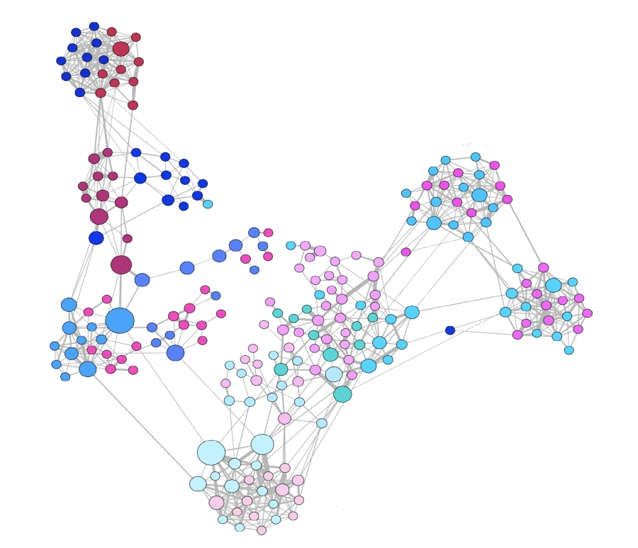
RFID
Digital badge that detects proximity to other badges
Interactions detected between individuals who wear the badge and face each other
Not scale-free, but large〈k²〉
Duration of interaction follows power law
Cumulative interaction time follows power law
Interactions not recorded by RFID may still spread pathogen
High school contact network captured with RFIDs
Notes:
Cell phone based technologies may be able to improve the accuracy of these types of networks

Slide 10
Location Network
Nodes are locations
Edges are individual movement between locations
Also scale-free
Many nodes with small degrees - homes
Hubs with very large degrees
Malls, airports, schools, supermarkets
Connected to many smaller locations - homes/offices
Hubs can rapidly spread a pathogen to many locations

Slide 11
Digital Viruses
Can spread similarly to real pathogens
Contact network depends on nature of virus
Email - spreads to email addresses found on computer
Email network - scale-free
Communication protocols
Also scale-free
IP addresses
Fully-connected local IP network
MMS
Mobile call network - scale-free
Bluetooth
Physical proximity

Slide 12
Conclusion
Contact networks affect the spread of biological and digital viruses
Modern technology allows for the mapping of these networks
Many contact networks are scale-free
STD network, air transportation, location network
Those that are not scale-free usually have high〈k²〉
Local contact network
Heterogenous property of scale-free and large〈k2〉networks allows for the spread of even weak viruses

Slide 13
Questions?

Slide 14
References
Barabási, A.-L. (2016). Network Science. Cambridge University Press.

